Slide 1

COMPUTER NETWORKS M23DE0203
UNIT-I
School of CSA/ MCA- 2nd Semester
Prof.Nagaraj C

Slide 2
UNIT I

Slide 3
CONTENTS:
INTRODUCTION: Network applications, network hardware, network software, reference models: OSI, TCP/IP, Internet.
THE PHYSICAL LAYER: signals, Transmission impairment, transmission: serial transmission, guided transmission media, wireless transmission, the public switched telephone networks, mobile telephone system.

Slide 4
LECTURE 1
AGENDA:
Introduction
Data Communication
Components of Data Communication
Computer Networks Definition
Elements of Network
Why we need computer networks
Why Is Network Topology Important
Quiz

Slide 5
INTRODUCTION:
A network is a set of devices (often referred to as nodes) connected by communication links.
A node can be a computer, printer, or any other device capable of sending and/or receiving data generated by other nodes on the network.
“Computer network’’ to mean a collection of autonomous computers interconnected by a single technology.
Two computers are said to be interconnected if they are able to exchange information.
The connection need not be via a copper wire; fiber optics, microwaves, infrared, and communication satellites can also be used.

Slide 6
USES OF COMPUTER NETWORKS:
Business Applications: to distribute information throughout the company (resource sharing). sharing physical resources such as printers, and tape backup systems, is sharing information
Client-server model: It is widely used and forms the basis of much network usage.
Communication medium: among employees.email (electronic mail), which employees generally use for a great deal of daily communication.
Telephone calls between employees may be carried by the computer network instead of by the phone company. This technology is called IP telephony or Voice over IP (VoIP) when Internet technology is used.

Slide 7
USES OF COMPUTER NETWORKS:
Desktop sharing lets remote workers see and interact with a graphical computer screen
doing business electronically, especially with customers and suppliers. This new model is called e-commerce (electronic commerce) and it has grown rapidly in recent years.
Home Applications
peer-to-peer communication Skype/Zoom-Calls were direct peer-to-peer, meaning your device connected directly to the other person's device without going through a central server.
person-to-person communication -Two people talking in person, like in a café or meeting.
electronic commerce
entertainment.(game playing,)

Slide 8
USES OF COMPUTER NETWORKS:
Mobile Users:
Text messaging or texting
Smart phones,
GPS (Global Positioning System)
m-commerce
NFC (Near Field Communication)
Social Issues:
With the good comes the bad, as this new-found freedom brings with it many unsolved social, political, and ethical issues.

Slide 9
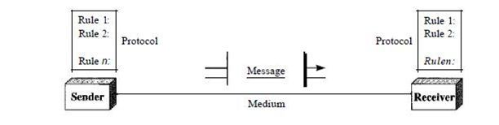
INTRODUCTION:
Data Communication:
Communication -sharing information.
Local-face to face
Remote-over distance.
Components of Data Communication:

Slide 10
Message: It is the information to be communicated Ex: Text, numbers, images, Sound and video, etc.
Sender: The device that sends the messages Ex: computer, a telephone Mic, video camera, etc.
Receiver: The device that receives the message. Ex: computer, a telephone Receiver, Television, etc.
Medium: The physical path by which a message travels from sender to receiver. Ex: Twisted pair wires, coaxial cable, and optical fiber
Protocol: A set of rules that govern data communication. Ex: HTTP, FTP, TELNET, SMTP, TCP

Slide 11
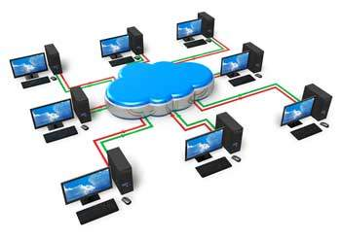
Computer Networks:
Multiple computers are connected to each other
Share information and resources.
Elements of Network:
Every Network includes
At least two or more Computer, Server and Client
Networking Interface card (NIC)
Transmission Medium
Network Operating System.(windows, UNIX, LINUX)

Slide 12
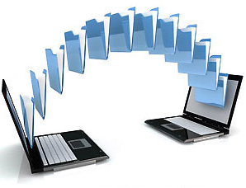
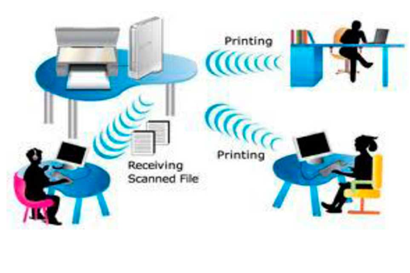
Why we need computer networks?
1.Filesharing
2.Hardware sharing

Slide 13
3. Application sharing:
Applications can be shared over the network.
Example: MS teams
4. User communication:
Users to communicate using e-mail, Whatsapp, Messanger, Instagram.
5. Network gaming:
Network(online) games
Example: Ludo King, Candy Crush Saga, Bubble Shooter, PUBG
6. Voice over IP (VoIP):
Voice data

Slide 14
Network Topology:
It refers to how various nodes, devices, and connections on your network are physically or logically arranged.
There are two approaches to network topology: physical and logical.
Physical network topology: the actual connections (wires, cables, etc.) of how the network is arranged.
Logical network topology: understanding of how and why the network is arranged
how data moves through it.

Slide 15
Why Is Network Topology Important?
How well network functions.
Increase performance
Easier to locate faults
Troubleshoot errors
More effectively allocate resources
Increase energy and data efficiency
Reduce operational and maintenance costs.

Slide 16
Quiz 1:
1. One important characteristic of LAN is…
(A) parallel transmission (B) low cast access for low bandwidth channel
(C) unlimited expansion (D) application independent interfaces
ANSWER: D
2. Communication between a computer and a keyboard involves ______________ transmission. (A) Automatic (B) Half-duplex (C ) Full-duplex (D) Simplex
ANSWER: D

Slide 17
3. Three or more devices share a link in ________ connection. (A) Unipoint (B) Multipoint (C) Point to point (D) Simplex
ANSWER: B
4. Bluetooth is an example of __________ (A) personal area network (B) local area network (C) virtual private network (D) wide area network
ANSWER: A

Slide 18
5. Buffering is….
(A) the process of temporarily storing the data to allow for small variation in device speeds.
(B) a method to reduce cross-talks
(C) storage of data within the transmitting medium until the receiver is ready to receive
(D) a method to reduce the routing overhead
ANSWER: A

Slide 19
Summary :
Data Communication
Components of Data Communication
Computer Networks Definition
Elements of Network
Why we need computer networks
Why Is Network Topology Important
Quiz

Slide 20
Lecture 2
RECAP:
Data Communication
Components of Data Communication
Computer Networks Definition
Elements of Network
Why we need computer networks
Why Is Network Topology Important
Quiz
AGENDA:
Types of Topology
BUS Topology
Advantages
Disadvantages
Star Topology
Advantages
Disadvantages
Ring Topology
Advantages
Disadvantages
Quiz

Slide 21
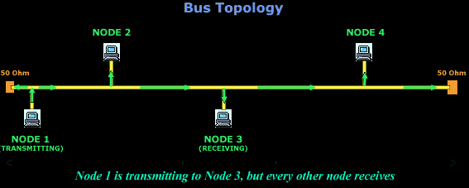
TYPES OF TOPOLOGY:
Bus Topology 2. Star Topology 3. Ring Topology 4. Mesh Topology
5. Hybrid Topology
1. BUS Topology:
“All the network devices are connected to single long cable called BUS/BACKBONE”

Slide 22
Advantages:
Easy to use and install.
Easy to add extra workstations.
Requires less cabling.
Failure of one node does not affect the rest of the network.
Less expensive.
Disadvantages:
Problem with the central cable- the entire network stops working
lot of workstations-data can travel slowly.
Network busy-Data collision
Low security
Cannot be suitable for larger networks.
Fault identification is difficult.
Failure of the cable will shut down the entire network.

Slide 23
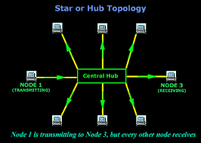
2. Star Topology: “All the network devices are connected to central device Switch or Router”.

Slide 24
Advantages:
Easy to use and install.
Easy to reconfigure.
Failure of one node does not affect the rest of the network.
Fault identification is easy.
Disadvantages:
If the HUB fails the entire network fails.
Require large amount of cable.
It is expensive.

Slide 25
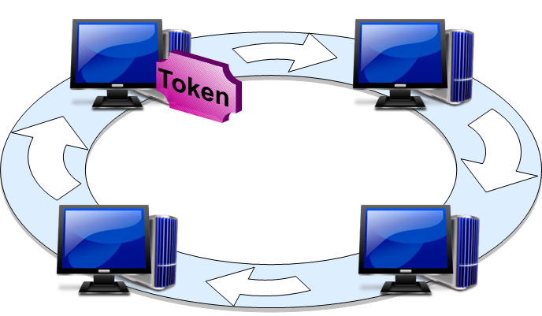
3. Ring Topology:
“all the devices are connected to one another in the shape of a closed ring”
Data is transmitted around the ring in one direction only from device to device until it reaches its destination.
Sending and receiving of data takes place with the help of token
In token passing protocol a machine can only use the network when it has control of the Token, this ensures that there are no collisions

Slide 26
Advantages:
Easy to use and install.
Easy to reconfigure.
All the nodes on the network have equal access to the network.
Fault identification is easy.
Disadvantages:
Signal is passed only in one direction.
A break in the ring can disable the entire network.
Adding or removing the node disrupts the entire network.

Slide 27
Quiz 2:
1) A piece of information which is sent along with the data to the source computer.
Data B) module C) token D) element
Answer: C
2) Which topology requires a multi point connection?
Mesh B)Star C)BUS D)Ring
Answer: C

Slide 28
3) Data communication system spanning states, countries, or the whole world is________ A) LAN B) WAN C) MAN D) PAN
Answer: B
4) Terminators are used in ______ topology. A) Bus B) Star C)Mesh
Answer : A

Slide 29
Summary :
Types of Topology
BUS Topology
Advantages
Disadvantages
Star Topology
Advantages
Disadvantages
Ring Topology
Advantages
Disadvantages
Quiz

Slide 30
Lecture 3
RECAP :
Types of Topology
BUS Topology
Advantages
Disadvantages
Star Topology
Advantages
Disadvantages
Ring Topology
Advantages
Disadvantages
Quiz
AGENDA:
Mesh Topology
Advantages
Disadvantages
Hybrid Topology
Advantages
Disadvantages
Computer Network Components
Hardware Components
Quiz

Slide 31
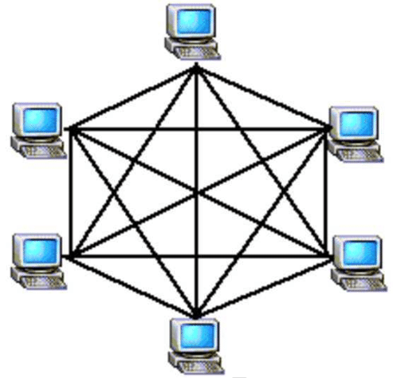
4. Mesh Topology:
Each device is connected to every other device on the network through a dedicated point-to-point link.

Slide 32
Advantages:
It is robust and reliable.
Easy to reconfigure.
Data transfer rate is very fast.
Eliminates traffic problem due to dedicated link.
Fault isolation is easy.
Disadvantages:
Installation and re-configuration is very difficult.
It is very expensive.
Cable requirement is very high.
Large numbers of input or output ports are required for each node.

Slide 33
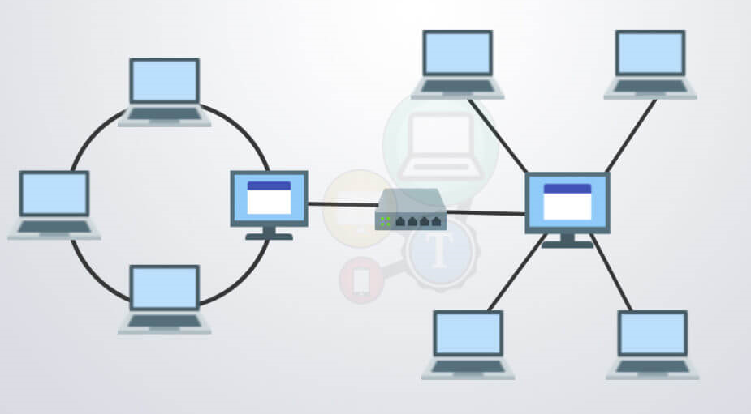
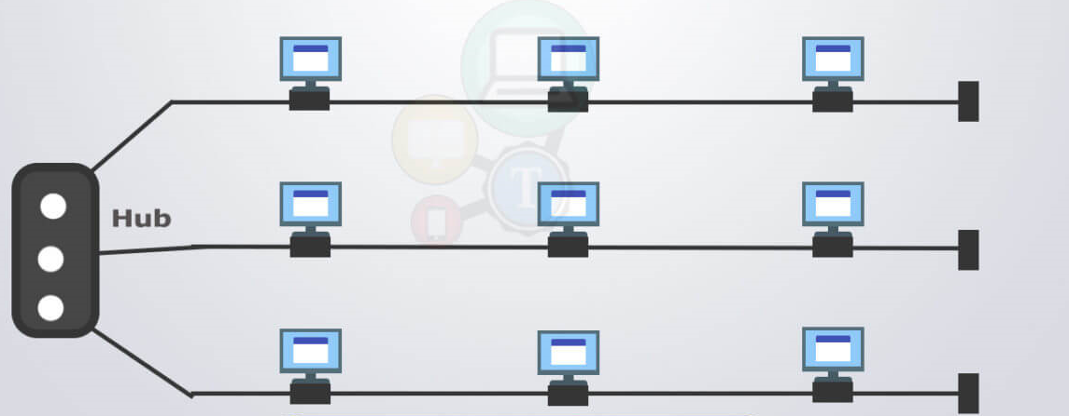
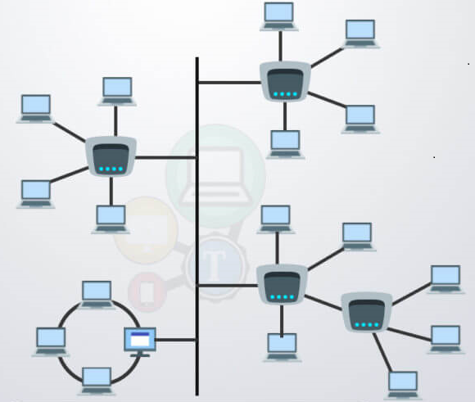
5. Hybrid Topology:
“It is the combination of two or more topologies”
Ring and Star
Bus and Star
Bus-Star-Ring

Slide 34
Advantages:
Super reliable and fault tolerant
Highly flexible and scalable
Robust
Disadvantages:
Expensive due to the use of variety of network devices and cable types
Extremely complex structure to create and manage
Computer Network Components:
Comprise of both physical parts as well as the software required for installing computer networks

Slide 35
Hardware Components:
Servers:
Manage the resources of the network.
Servers can be of various kinds: file servers, database servers, print servers etc. ATM machines - real-time, interactive, client-server
Clients:
Computers that request and receive service from the servers to access and use the network resources.
Peers:
Peers are computers that provide as well as receive services from other peers in a workgroup network.

Slide 36
Transmission Media:
Through which data is transferred from one device to another in a network.
Transmission media may be guided media like coaxial cable, fibre optic cables etc; or maybe unguided media like microwaves, infra-red waves etc.
Connecting Devices:
Act as middleware between networks or computers by binding the network media together.
Some of the common connecting devices are: Router, Bridges, Hubs, Repeaters, Gateways, Switches

Slide 37
Quiz 3:
1) In which topology, if there are n devices in a network, each device has n-1 ports for cables ?
Mesh B)Star C)Ring D)Bus
Answer: A
2) A device which is used to boost the signal between two cable segments or wireless access points is A) Booster B) Repeater C) Switch D) Router
Answer: C

Slide 38
3) A device that helps prevent congestion and data collisions A) Switch B) Hub C) Gateway D) Proxy Server
Answer: A
4) A device that is used to connect a number of LANs is – A) Router B) Repeater C) Bridge D) Switch
Answer: A

Slide 39
5) What is the use of Bridge in Network? A) to connect LANs B) to separate LANs
C) to control Network Speed D) All of the above
Answer: A
6) What is a Firewall in Computer Network? A) The physical boundary of Network B) An operating System of Computer Network C) A system designed to prevent unauthorized access D) A web browsing Software
Answer: C

Slide 40
Summary :
Mesh Topology
Advantages
Disadvantages
Hybrid Topology
Advantages
Disadvantages
Computer Network Components
Hardware Components
Quiz

Slide 41
Lecture 4
RECAP:
Mesh Topology
Advantages
Disadvantages
Hybrid Topology
Advantages
Disadvantages
Computer Network Components
Hardware Components
Quiz
AGENDA:
Software component
Protocols
Standards
De facto
De jure
Layered tasks
Quiz

Slide 42
Computer Network Components:
Software Components:
Networking Operating System − It is installed in the server and facilitate workstations in a network to share files, database, applications, printers etc.
Protocol Suite:
Protocol: Rule or guideline followed by each computer for data communication.
Protocol suite is a set of related protocols that are laid down for computer networks.
The two popular protocol suites are:
OSI Model ( Open System Interconnections)
TCP / IP Model

Slide 43
PROTOCOLS AND STANDARDS:
PROTOCOLS :
In computer networks, communication occurs between entities in different systems.
An entity is anything capable of sending or receiving information.
Two entities cannot simply send bit streams to each other and expect to be understood.
For communication to occur, the entities must agree on a protocol.
A protocol is a set of rules that govern data communications.
A protocol defines what is communicated, how it is communicated, and when it is communicated.

Slide 44
STANDARDS:
Standards provide guidelines to manufacturers, vendors, government agencies, and other service providers
Ensure the kind of interconnectivity necessary in today's marketplace and in international communications.
Data communication standards fall into two categories:
de facto (meaning "by fact" or "by convention") and de jure (meaning "by law" or "by regulation").
De facto: Standards that have not been approved by an organized body but have been adopted as standards through widespread use are de facto standards.
De jure: Those standards that have been legislated by an officially recognized body are de jure standards.

Slide 45
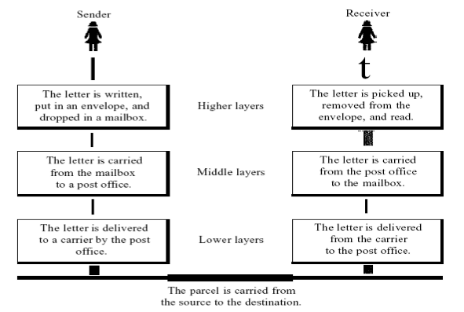
LAYERED TASKS
Let us consider two friends who communicate through postal mail.

Slide 46
Quiz 4:
1) Communication channel is shared by all the machines on the network in:
A) broadcast network
B) unicast network
C) multicast network
D) none of the mentioned
Answer: A
2) How many bits are there in the Ethernet address? A) 64 bits B) 48 bits C) 32 bits D) 16 bits
Answer: B

Slide 47
Summary :
Software component
Protocols
Standards
De facto
De jure
Layered tasks
Quiz

Slide 48
Lecture 5
RECAP :
Software component
Protocols
Standards
De facto
De jure
Layered tasks
Quiz
AGENDA:
OSI Model
Application Layer
Presentation layer
Session Layer
Quiz

Slide 49
The Open System Interconnection (OSI) Reference Model:
OSI (Open System Interconnect) model is a standard description of how messages should be transmitted between any two communicating parties in a network.
It was introduced by an ISO (International Standard Organization) in 1984.
From ISO's perspective, the easiest way to create a conceptual model was to organize the models into different abstraction layers required to organize and send data between computing systems.

Slide 50
How the OSI model works
Information technology (IT) networking professionals use OSI to model or conceptualize how data is sent or received over a network.
Understanding this is a foundational part of most IT networking certifications, including the Cisco Certified Network Associate (CCNA) and CompTIA Network+ certification programs.
As mentioned, the model is designed to break down data transmission standards, processes and protocols over a series of seven layers, each of which is responsible for performing specific tasks concerning sending and receiving data.

Slide 51
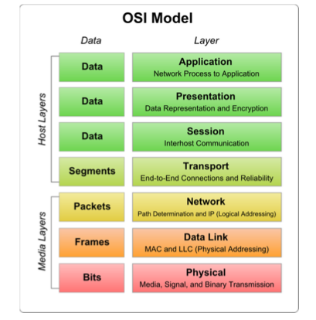

Slide 52
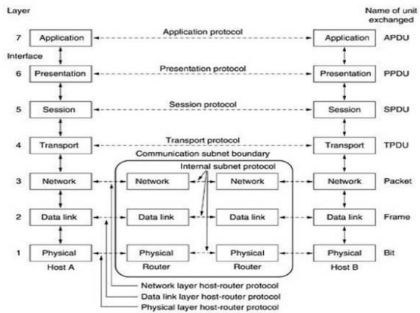

Slide 53
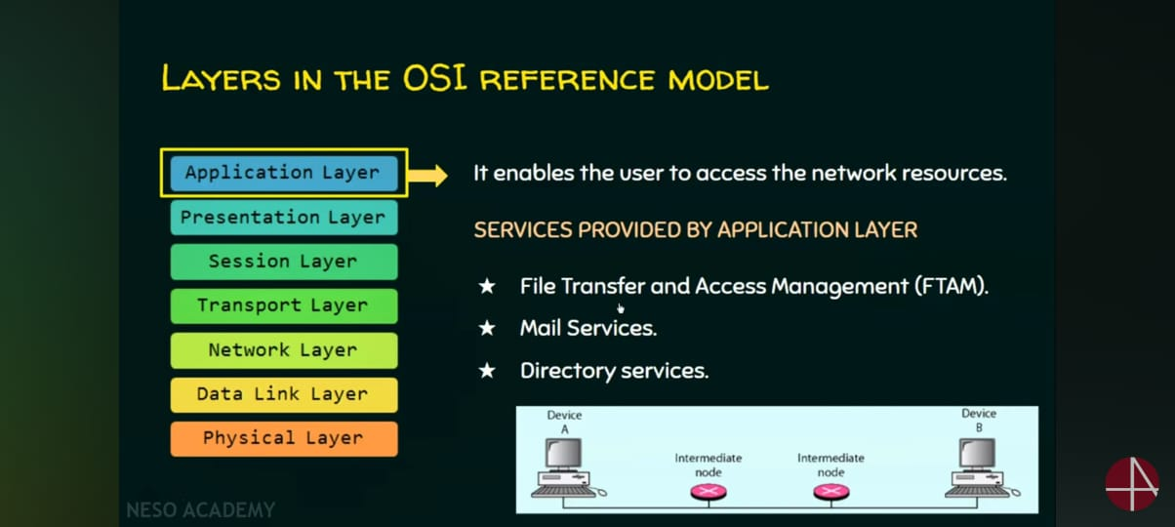

Slide 54
Application Layer:
It provides user interface and support for services such as e-mail, file transfer, database sharing
The application layer enables the user -- human or software -- to interact with the application or network whenever the user elects to read messages, transfer files or perform other network-related tasks.
Web browsers and other internet-connected apps, such as Outlook and Skype, use Layer 7 application protocols.

Slide 55
Presentation layer: The presentation layer translates or formats data for the application layer based on the semantics or syntax the application accepts.
Specific responsibilities of presentation layer are:
Translation : Changing the format of a message that is used by the sender into mutually acceptable for transmission then at the destination changing that format into one understood by the receiver.
Encryption : Encryption & decryption of data for security purpose.
Compression : Compressing & decompressing data to make transmission more efficient.
Security : Validating password and login codes.

Slide 56
Session Layer :
The session layer sets up, coordinates and terminates conversations between applications.
Its services include authentication and reconnection after an interruption.
This layer determines how long a system will wait for another application to respond.
Session management : Dividing a session into sessions by the introduction of checkpoints(marking the significant parts of the message) and separating long messages into shorter units called dialog units.

Slide 57
Session Layer :
Synchronization : (checkpoints in long transmissions)Deciding in what order to pass the dialog units & making sure that the previous request has been fulfilled before the next one is sent.
Lock and Execution in synchronization
Dialog control : Deciding who sends the data ,when and how much
Graceful close : Ensuring that the exchange of data has been completed appropriately before the session closes.

Slide 58
Transport Layer :
The Transport Layer is responsible for end-to-end communication between devices. It ensures that data is delivered error-free, in sequence, and without losses or duplicates.
The transport layer is responsible for source to destination of delivery of the entire message
Specific responsibilities of transport layer are:
Segmentation & Reassembly: Splits large data from the upper layers into smaller segments for transmission and reassembles them at the receiver’s side.
Reliable Data Transfer: Uses acknowledgments and retransmissions to guarantee delivery (in protocols like TCP).
Flow Control: Prevents overwhelming the receiver by managing data transfer rate.
Error Detection and Recovery: Detects errors and requests retransmission if needed.
Multiplexing: Allows multiple applications on a device to use the network simultaneously by assigning port numbers. (Multiplexing allows many mobile users to share the network efficiently without interfering with each other.)

Slide 59
Network Layer :
The primary function of the network layer is to move data into and through other networks.
Network layer protocols accomplish this by packaging data with correct network address information, selecting the appropriate network routes and forwarding the packaged data up the stack to the transport layer.
From a TCP/IP perspective, this is where IP addresses are applied for routing purposes.

Slide 60
Specific responsibilities of network layer are:
Source to destination delivery of packet.
Ensures that data is delivered from the sender to the final receiver, even if they are on different networks.
Unlike the Data Link Layer (which works within a single network), the Network Layer can forward data across many networks.
Logical addressing :
Every device on a network is assigned a logical address (e.g., an IP address).
The source and destination IP addresses are included in the packet header.
This ensures that the packet is routed correctly to the final device.

Slide 61
Specific responsibilities of network layer are:
Switching :
Refers to how packets are moved from one network segment to another.
Routers and Layer 3 switches perform packet switching.
The Network Layer decides how to forward packets, but doesn’t create the physical connection — that’s a Data Link/Physical Layer job.
So packet switching is a part of the Network Layer’s function.
Routing : Selecting the best path for sending a packet
Most important role of the Network Layer.
Finds the best path from source to destination across multiple routers.
Uses routing algorithms (Distance Vector,Link State..)
Routing tables help determine the next hop for a packet.

Slide 62
Data Link Layer:
The Data Link Layer is responsible for reliable communication between two directly connected devices on the same network (like two computers in the same Wi-Fi network or LAN).
Main Responsibilities of the Data Link Layer:
1. Framing
Framing means dividing the data into small parts called frames. Each frame includes not just the data, but also information that helps the receiver know where the frame starts and ends.
2. Physical Addressing
The Data Link Layer adds the MAC address of the sender and receiver to each frame. This ensures that the data reaches the correct device on the local network.

Slide 63
3. Error Detection and Correction
Before sending, the frame includes an error-checking code (like CRC). At the receiver’s end, this code is checked to see if the data was changed during transmission. If an error is found, it can be corrected or resent.
4. Flow Control
Flow control manages the speed of data transfer so that a fast sender does not overload a slow receiver. This keeps the communication smooth and reliable.
5. Access Control
In a network where many devices share the same link (like Wi-Fi or Ethernet), access control decides which device can send data at a time to avoid collisions.

Slide 64
Physical Layer :
The Physical Layer is the lowest layer of the OSI model. It is responsible for the actual transmission of raw bits (0s and 1s) over a physical medium like cables, radio waves, or fiber optics.
What It Does:
Converts digital data from the Data Link Layer into electrical, optical, or radio signals.
Defines the hardware specifications such as cables, connectors, voltage levels, and signal timing.
Manages how devices physically connect and transmit bits on the network.
Deals with the transmission and reception of unstructured raw data (bits) without interpretation.

Slide 65
Physical Layer :
Function | Explanation
Bit transmission | Sends raw bits over a physical medium.
Physical connection | Specifies cables, connectors, and signaling.
Data rate control | Defines how fast bits are sent.
Synchronization | Ensures sender and receiver are synchronized on bit timing.
Medium type | Defines if it’s copper cable, fiber, or wireless.

Slide 66
Quiz 7:
1. Which layer of the OSI model is responsible for end-to-end communication and error recovery?
a) Physical Layer b) Transport Layer c) Network Layer d) Data Link Layer
Answer: b) Transport Layer
2. At which layer does the Logical Addressing (IP addressing) occur in the OSI model?
a) Data Link Layer b) Network Layer c) Transport Layer d) Session Layer
Answer: b) Network Layer

Slide 67
Quiz 7:
3. Which OSI layer is responsible for converting data into electrical, optical, or radio signals?
a) Session Layer b) Physical Layer c) Presentation Layer d) Network Layer
Answer: b) Physical Layer
4. The Data Link Layer provides which of the following services?
a) Path determination and logical addressing b) Framing and error detection c) End-to-end communication and flow control d) Data encryption and compression
Answer: b) Framing and error detection
5. Which OSI layer establishes, manages, and terminates sessions between applications?
a) Transport Layer b) Network Layer c) Session Layer d) Presentation Layer
Answer: c) Session Layer

Slide 68
SUMMARY:
OSI Model
Data Link Layer
Physical Layer
Quiz

Slide 69
Lecture 8
RECAP:
OSI Model
Data Link Layer
Physical Layer
Quiz
AGENDA:
What application or protocol resides at each of the layers Data Link Layer
How does the OSI model help you on a practical basis
The TCP/IP Reference Model
Quiz

Slide 70
“What application or protocol resides at each of the layers?”
Layer 7 – Application:
The application layer is where the protocols and services that make up your application reside.
Examples of what is located here are: Telnet, File Transfer Protocol (FTP), and Simple Mail Transfer Protocol (SMTP).
Layer 6 – Presentation:
The presentation layer "presents" the session layer data to the application.
Examples of what is located here are: encryption (like IPSec), ASCII, and JPG.

Slide 71
“What application or protocol resides at each of the layers?”
Layer 5 – Session:
This layer is responsible for initiating and terminating network connections.
Examples of the session layer are Remote Procedure Call (RPC) functions and the login portion of a SQL session.
Layer 4 - Transport TCP and UDP work at the transport layer.
TCP provides the reliable, in-order delivery of your data, as well as error correction, sequencing, and windowing (flow control).
Additionally, TCP at the transport layer provides source and destination port numbers that are commonly associated with applications.
For example, TCP port 25 is SMTP, 23 is telnet, 22 is SSH, 80 is HTTP, and so on.

Slide 72
“What application or protocol resides at each of the layers?”
Layer 3 – Network:
The network layer is where the "IP" part of "TCP/IP" happens.
IP is responsible for addressing in the network.
Because IP works at layer 3, you could also say that routing and routers work at layer 3.
Any data at layer 3 is called a packet.

Slide 73
How does the OSI model help you on a practical basis?
By understanding the OSI model, you can see the "big picture" of how the network really works.
understand how bits are sent as electrical signals across copper wires;
How those are reassembled into frames by Ethernet in layer 2;
How the frames are switched to the right destination;
How that PC disassembles the frame and packet to verify that it is the right destination IP;
How it breaks up the segment at the transport layer
How it responds with an acknowledgement (ACK), and sends the data up to the session, presentation, and application layers;
How every tiny communication requires this whole process to happen many times per second.

Slide 74
The TCP/IP Reference Model :
TCP/IP stands for Transmission Control Protocol/Internet Protocol.
TCP/IP is a set of standardized rules that allow computers to communicate on a network such as the internet.
The two computers need to know,
How do they start the conversation?
Whose turn is it to communicate?
How does each computer know its message was transmitted correctly?
How do they end the conversation?
Computers do this through protocols. Protocols are set of rules which govern every possible communication over a network
.
These protocols describe the movement of data between the source and destination or the internet. They also offer simple naming and addressing schemes.

Slide 75
Quiz 8:
1) Which of the following is false with respect to TCP? A) Connection-oriented B) Process-to-process C) Transport layer protocol D) Unreliable Answer: D
2) Communication offered by TCP is ________ A) Full-duplex B) Half-duplex C) Semi-duplex D) Byte by byte Answer: A

Slide 76
SUMMARY:
What application or protocol resides at each of the layers Data Link Layer
How does the OSI model help you on a practical basis
The TCP/IP Reference Model
Quiz

Slide 77
Lecture 9
RECAP:
What application or protocol resides at each of the layers Data Link Layer
How does the OSI model help you on a practical basis
The TCP/IP Reference Model
Quiz
AGENDA:
Different Layers of TCP/IP Reference Model
Protocols and networks in the TCP/IP model
Layer 1
Layer 2
Layer 3
Layer 4
Transmission Media
Quiz

Slide 78
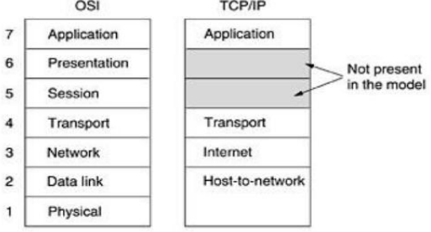
Different Layers of TCP/IP Reference Model:

Slide 79
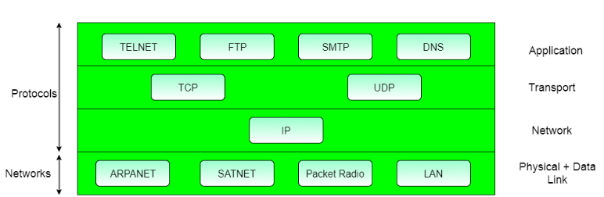
Protocols and networks in the TCP/IP model:

Slide 80
Layer 1: Host-to-network Layer
Protocol is used to connect to the host, so that the packets can be sent over it.
Varies from host to host and network to network.
Layer 2: Internet layer
Selection of a packet switching network which is based on a connectionless internetwork layer is called a internet layer.
It is the layer which holds the whole architecture together.
It helps the packet to travel independently to the destination.

Slide 81
Layer 2: Internet layer
Order in which packets are received is different from the way they are sent.
IP (Internet Protocol) is used in this layer.
The various functions performed by the Internet Layer are:
Delivering IP packets
Performing routing
Avoiding congestion

Slide 82
Layer 3: Transport Layer
It decides if data transmission should be on parallel path or single path.
Functions such as multiplexing, segmenting or splitting on the data is done by transport layer.
The applications can read and write to the transport layer.
Transport layer adds header information to the data.
Transport layer breaks the message (data) into small units so that they are handled more efficiently by the network layer.
Transport layer also arrange the packets to be sent, in sequence.
It defines two end-to-end protocols: TCP and UDP

Slide 83
Layer 4: Application Layer
The TCP/IP applications were TELNET, FTP, SMTP, DNS etc.
TELNET is a two-way communication protocol which allows connecting to a remote machine and run applications on it.
FTP(File Transfer Protocol) is a protocol, that allows File transfer amongst computer users connected over a network. It is reliable, simple and efficient.
SMTP(Simple Mail Transport Protocol) is a protocol, which is used to transport electronic mail between a source and destination.
DNS(Domain Name Server) resolves an IP address into a textual address for Hosts connected over a network.

Slide 84
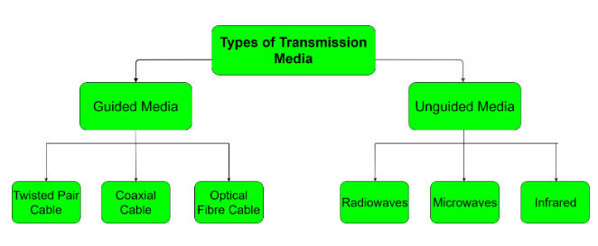
Transmission Media :
Physical path between the transmitter and the receiver
It is the channel through which data is sent from one place to another.
Transmission Media is broadly classified into the following types:

Slide 85
Quiz 9:
1) To achieve reliable transport in TCP, ___________ is used to check the safe and sound arrival of data. A) Packet B) Buffer C) Segment D) Acknowledgment Answer: D
2) Which layer is responsible for process-to-process delivery? A) Physical layer B) Network layer C) Transport layer D) Application layer Answer: C

Slide 86
SUMMARY:
Different Layers of TCP/IP Reference Model
Protocols and networks in the TCP/IP model
Layer 1
Layer 2
Layer 3
Layer 4
Transmission Media
Quiz

Slide 87
Lecture 10
RECAP:
Different Layers of TCP/IP Reference Model
Protocols and networks in the TCP/IP model
Layer 1
Layer 2
Layer 3
Layer 4
Transmission Media
Quiz
AGENDA:
Guided Media
Twisted Pair Cable
Unshielded Twisted Pair (UTP) Cable
Shielded Twisted Pair (STP) Cable
Coaxial Cable
Optical Fibre Cable
Quiz

Slide 88
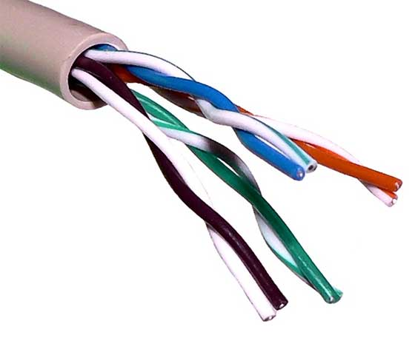
Guided Media:
In this type, the signals can be transmitted directly & restricted in a thin path through physical links.
Features
Secure
high-speed
used in small distances.
This kind of media is classified into three types which are discussed below.
Twisted Pair Cable:
It consists of 2 separately insulated conductor wires wound
about each other.

Slide 89
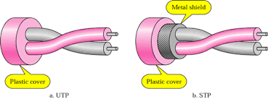
There are two types of twisted pair cables:
Unshielded Twisted Pair (UTP) Cable
Shielded Twisted Pair (STP) Cable
UTP (Unshielded Twisted Pair):
This UTP cable has the capacity to block interference.
It doesn’t depend on a physical guard and used in telephonic applications.
Advantage:
Low cost
Very simple to install
High speed.
Disadvantages:
Liable to exterior interference
Transmits in fewer distances
Less capacity.

Slide 90
Shielded Twisted Pair (STP):
This type of cable consists of a special jacket to block external interference.
It is used in fast-data-rate Ethernet and in voice and data channels of telephone lines.
Advantages:
Better performance at a higher data rate in comparison to UTP
Eliminates crosstalk
Comparitively faster
Disadvantages:
Comparatively difficult to install and manufacture
More expensive
Bulky

Slide 91
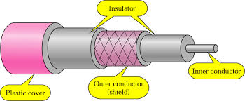
2) Coaxial Cable:
It has an outer plastic covering containing 2 parallel conductors each having a separate insulated protection cover.
Cable TVs and analog television networks widely use Coaxial cables.
Advantages:
High Bandwidth
Better noise Immunity
Easy to install and expand
Inexpensive
Disadvantages:
Single cable failure can disrupt the entire network

Slide 92
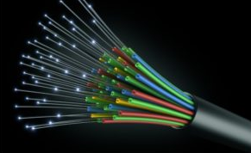
3) Optical Fibre Cable:
It uses the concept of reflection of light through a core made up of glass or plastic.
The core is surrounded by a less dense glass or plastic covering called the cladding.
It is used for transmission of large volumes of data.

Slide 93
Advantages:
Increased capacity and bandwidth
Light weight
Less signal attenuation
Immunity to electromagnetic interference
Resistance to corrosive materials
Disadvantages:
Difficult to install and maintain
High cost
unidirectional, ie, will need another fibre, if we need bidirectional communication

Slide 94
Quiz 10:
1) Which transmission media provides the highest transmission speed in a network? A) coaxial cable B) twisted pair cable C) optical fiber D) electrical cable Answer: C
2) Bits can be sent over guided and unguided media as analog signal by ___________ A) digital modulation B) amplitude modulation C) frequency modulation D) phase modulation Answer: A

Slide 95
Quiz 10:
3) Fiber optics posses following properties __________ A) Immune electromagnetic interference B) Very less signal attenuation C) Very hard to tap D) All of the mentioned Answer: D
4) Radio channels are attractive medium because __________ A) Can penetrate walls B) Connectivity can be given to mobile user C) Can carry signals for long distance D) All of the mentioned Answer: D

Slide 96
SUMMARY:
Guided Media
Twisted Pair Cable
Unshielded Twisted Pair (UTP) Cable
Shielded Twisted Pair (STP) Cable
Coaxial Cable
Optical Fibre Cable
Quiz

Slide 97
Lecture 11
RECAP:
Guided Media
Twisted Pair Cable
Unshielded Twisted Pair (UTP) Cable
Shielded Twisted Pair (STP) Cable
Coaxial Cable
Optical Fibre Cable
Quiz
AGENDA:
Unguided Media
Radiowaves
Microwaves
Infrared
Digital Modulation
Types Digital Modulation
Quiz

Slide 98
Unguided Media:
It is also referred to as Wireless or Unbounded transmission media.
No physical medium is required for the transmission of electromagnetic signals.
Features:
Signal is broadcasted through air
Less Secure
Used for larger distances

Slide 99
There are 3 major types of Unguided Media:
Radiowaves :
These are easy to generate and can penetrate through buildings.
The sending and receiving antennas need not be aligned.
Frequency Range:3KHz – 1GHz.
AM and FM radios and cordless phones use Radiowaves for transmission.

Slide 100
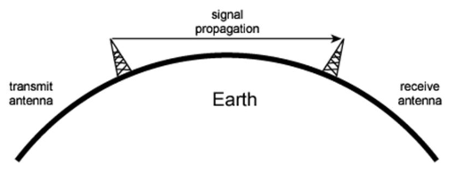
(ii)Microwaves:
It is a line of sight transmission i.e. the sending and receiving antennas need to be properly aligned with each other.
Frequency Range:1GHz – 300GHz.
These are majorly used for mobile phone communication and television distribution.
line of sight transmission

Slide 101
(iii) Infrared:
Infrared waves are used for very short distance communication.
They cannot penetrate through obstacles.
This prevents interference between systems.
Frequency Range:300GHz – 400THz.
It is used in TV remotes, wireless mouse, keyboard, printer, etc.

Slide 102
Digital Modulation:
Fundamental to all wireless communications is modulation
It is the process of impressing the data to be transmitted on the radio carrier.
Digital modulation is the process of encoding a digital information signal into the amplitude, phase, or frequency of the transmitted signal.
Features:
Provides more information capacity,
High data security
Quicker system availability with great quality communication.

Slide 103
Types Digital Modulation:
ASK – Amplitude Shift Keying
FSK – Frequency Shift Keying
PSK – Phase Shift Keying

Slide 104
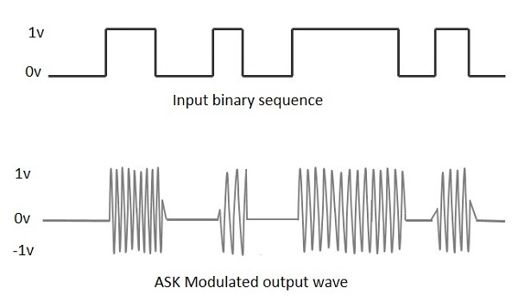
ASK – Amplitude Shift Keying: It is a type of Amplitude Modulation which represents the binary data in the form of variations in the amplitude of a signal

Slide 105
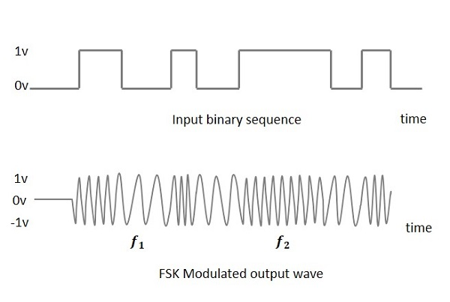
FSK-Frequency Shift Keying :
It is the digital modulation technique in which the frequency of the carrier signal varies according to the digital signal changes.
The binary 1s and 0s are called Mark and Space frequencies.

Slide 106
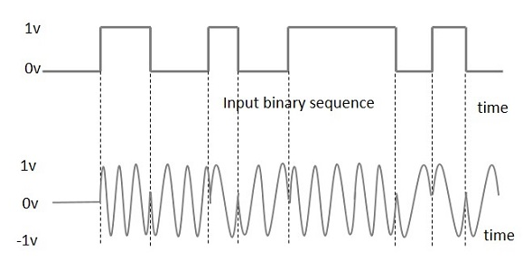
PSK-Phase Shift Keying:
PSK is the digital modulation technique in which the phase of the carrier signal is changed by varying the sine and cosine inputs at a particular time.
PSK technique is widely used for wireless LANs, bio-metric, contactless operations, along with RFID and Bluetooth communications.

Slide 107
Quiz 11:
1) Modern mobile communication systems use analog modulation techniques. State whether True or False. A) True B) False Answer: B
2) which of the following is not an advantage of digital modulation? A) Greater noise immunity B) Greater security C) Easier multiplexing D) Less bandwidth requirement Answer: D

Slide 108
Quiz 11:
1) A desirable modulation scheme provides ____ bit error rates at _____ received signal to noise ratios. A) Low, low B) Low, high C) High, high D) High, low Answer: A
2) In digital communication system, in order to increase noise immunity, it is necessary to increase _____. A) Signal power B) Signal amplitude C) Signal frequency D) Signal magnitude Answer: A

Slide 109
SUMMARY :
Unguided Media
Radio waves
Microwaves
Infrared
Digital Modulation
Types Digital Modulation
Quiz

Slide 110
Lecture 12
RECAP:
Unguided Media
Radio waves
Microwaves
Infrared
Digital Modulation
Types Digital Modulation
Quiz
AGENDA:
Multiplexing
Types of Multiplexing Techniques
Frequency Division Multiplexing (FDM)
Time Division Multiplexing (TDM)
Wavelength Division Multiplexing (WDM)
Quiz

Slide 111
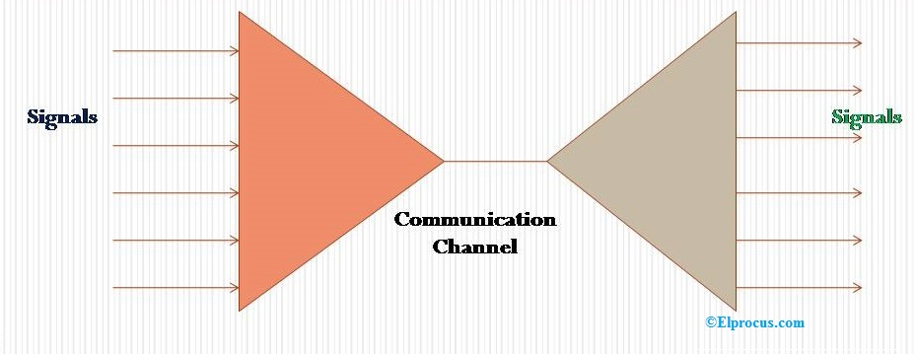
Multiplexing:
Transmitting various signals over a media or single line.
Transmitter-Multiplexer: n-input lines for generating a single output
Receiver-De-multiplexer: receives data from a single medium, identifies each
It has single input and number of outputs.

Slide 112
Types of Multiplexing Techniques:
Frequency Division Multiplexing (FDM)
Time Division Multiplexing (TDM)
Wavelength Division Multiplexing (WDM)

Slide 113
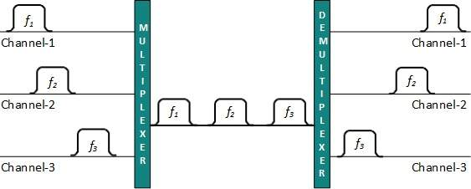
Frequency Division Multiplexing (FDM):
Each user can use the channel frequency independently and has exclusive access of it. All channels are divided in such a way that they do not overlap with each other.
Channels are separated by guard bands.
Guard band is a frequency which is not used by either channel.

Slide 114
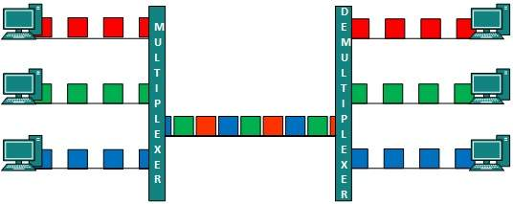
2) Time Division Multiplexing (TDM):
Each user can transmit data within the provided time slot only.
When channel A transmits its frame at one end, As soon as the channel A’s time slot expires, this side switches to channel B.

Slide 115
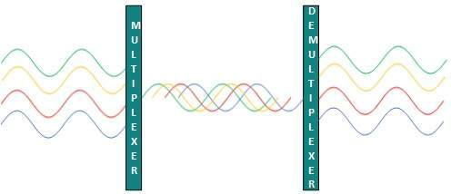
3) Wavelength Division Multiplexing (WDM):
Light has different wavelength (colors).
In fiber optic mode, multiple optical carrier signals are multiplexed into an optical fiber by using different wavelengths.

Slide 116
Quiz 12:
1) The sharing of a medium and its link by two or more devices is called _________ A) Fully duplexing B) Multiplexing C) Micropleixng D) Duplexing Answer: A
2) Which multiplexing technique used to transmit digital signals? A) FDM B) TDM C) WDM D) FDM & WDM Answer: B

Slide 117
Quiz 12:
3) Multiplexing provides _________ A) Efficiency B) Privacy C) Anti jamming D) Both Efficiency & Privacy Answer: D

Slide 118
SUMMARY :
Multiplexing
Types of Multiplexing Techniques
Frequency Division Multiplexing (FDM)
Time Division Multiplexing (TDM)
Wavelength Division Multiplexing (WDM)
Quiz

Slide 119
Lecture 13
RECAP:
Multiplexing
Types of Multiplexing Techniques
Frequency Division Multiplexing (FDM)
Time Division Multiplexing (TDM)
Wavelength Division Multiplexing (WDM)
Quiz
AGENDA:
Network Switching
Types Of Switching
Circuit Switching
Packet Switching
Packet Switching
Quiz

Slide 120
Network Switching:
Switching is process to forward packets coming in from one port to a port leading towards the destination
A communication system may include number of switches and nodes.
Types Of Switching:
Circuit Switching
Packet Switching
Message Switching

Slide 121
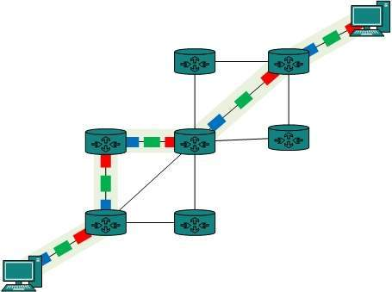
1) Circuit Switching:
When two nodes communicate with each other over a dedicated communication path, it is called circuit switching.
To transfer the data, circuit must be established so that the data transfer can take place.
Applications which use circuit switching may have to go through three phases:
Establish a circuit
Transfer the data
Disconnect the circuit
Circuit switching was designed for voice applications.
Telephone is the best suitable example of circuit switching. Before a user can make a call, a virtual path between caller and callee is established over the network.

Slide 122
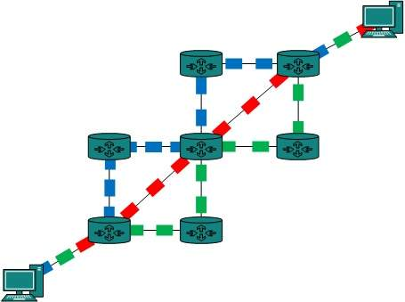
Advantages:
Data is transmitted without delays. 2. Suitable for long, continuous transmission of data.
Disadvantages:
There exists long connection establishment delay.
Both the nodes must be available at the same time for data exchange.
Resources must be available and dedicated through the network between two nodes.
2) Packet Switching:
The entire message is broken down into smaller chunks called packets.
The switching information is added in the header of each packet and transmitted independently.
The internet uses packet switching technique.

Slide 123
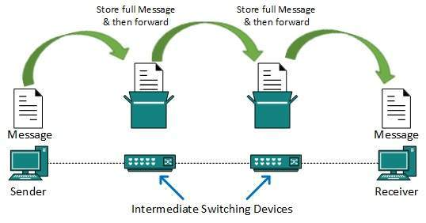
Advantages:
It makes very efficient use of networks.
It supports “busty” data transfer
Reduction in Time delay and increased throughput compared to message switching.
Disadvantages:
Data transmission delay compared to circuit switching.
Not very good for small data packets.
3) Message Switching:
It uses store and forward technique in which data is stored and forwarded from the source node to the destination node one “hop” at a "time”.
Example: Telegraph Network

Slide 124
Advantages:
Simultaneous availability of sender and receiver is not required.
Increased circuit utilization, since more devices can share the common data path.
In expensive technique.
Message priorities can be established due to store and forward technique.
Speed and code conversion is possible.
Disadvantages:
It does not support real time applications like voice and video.
Switches must have large storage capacities in order to store very long messages.
Long messages can block the links for a long time while they are being forwarded.
Data transmission delay is existed because of switching at each node.

Slide 125
Quiz 13:
A local telephone network is an example of a _______ network. A) Packet switched B) Circuit switched C) Bit switched D) Line switched Answer: B
The required resources for communication between end systems are reserved for the duration of the session between end systems in ________ method. A) Packet switching B) Circuit switching C) Line switching D) Frequency switching Answer: B

Slide 126
Quiz 13:
3) In _________ systems, resources are allocated on demand. A) packet switching B) circuit switching C) line switching D) frequency switching Answer: A

Slide 127
SUMMARY :
Network Switching
Types Of Switching
Circuit Switching
Packet Switching
Packet Switching
Quiz

Slide 128
Lecture 14
AGENDA:
The Mobile Telephone System
Generations of Mobile Phone Systems
Quiz
RECAP:
Network Switching
Types Of Switching
Circuit Switching
Packet Switching
Packet Switching
Quiz

Slide 129
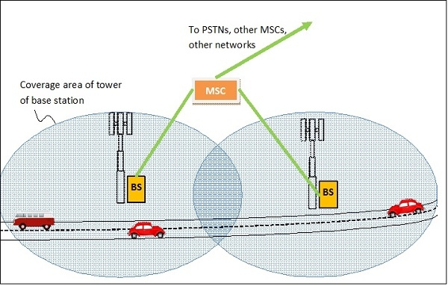
The Mobile Telephone System:
Mobile phones and other mobile devices, called mobile stations are connected to base stations.
Communication between the mobile stations and the base stations are done by wireless radio signals
Each base station has a coverage area around it, such that mobile stations within this area can connect provided they have access permissions.
Base stations contain transmitters and receivers to convert radio signals to electrical signals and vice versa.
Base stations transmit the message in form of electrical signals to the mobile switching center (MSC).
MSCs are connected to other MSCs and public networks like PSTNs.

Slide 130
Generations of Mobile Phone Systems:
1G (First Generation) : They were standards for analog voice mobile phone communications.
2G(Second Generation) : They were standards for digital voice mobile phone communications.
3G(Third Generation) : These standards were for communications in form of both digital voice as well as digital data.
4G(Fourth Generation) : 4G standards provide mobile broadband internet access in addition to digital voice and data.
5G(Fifth Generation) : It is the next step of mobile communication standards beyond 4G which currently under development.

Slide 131
Generations of Mobile Phone Systems:
2G, first introduced in 1992, is the second-generation of cellular telephone technology and the first to use digital encryption of conversations. 2G networks were the first to offer data services and SMS text messaging, but their data transfer rates are lower than those of their successors.
3G networks succeed 2G ones, offering faster data transfer rates and are the first to enable video calls. This makes them especially suitable for use in modern smartphones, which require constant high-speed internet connection for many of their applications.

Slide 132
Generations of Mobile Phone Systems:
4G is the fourth generation of mobile phone communications standards. It is a successor of the 3G and provides ultra-broadband internet access for mobile devices. The high data transfer rates make 4G networks suitable for use in USB wireless modems for laptops and even home internet access.
5G is the fifth generation of mobile phone communications standards. It is a successor to 4G and promises to be faster than previous generations while opening up new uses cases for mobile data. The 5G benefits range from faster speeds (up to 10x faster), much lower latency (up to 50x lower) and greater capacity allowing many more devices to be connected at the same time.

Slide 133
Generations of Mobile Phone Systems:
Global System for Mobile communications (GSM)
LTE stands for Long Term Evolution
subscriber identification module (SIM)
public switched telephone networks (PSTN)
Analog voice
2. Digital voice
3. Digital voice and data

Slide 134
Quiz 14:
1) Who has the responsibility of billing and system maintenance function in cellular system? A) Base Station B) PSTN C) MSC D) Mobile system Answer: C
2) What is the shape of the cell present in the cellular system? A) Circular B) Square C) Hexagonal D) Triangular Answer: C

Slide 135
Quiz 14:
3) The process of transferring a mobile station from one base station to another is ____________ A) MSC B) Roamer C) Handoff D) Forward channel Answer: C

Slide 136
SUMMARY:
The Mobile Telephone System
Generations of Mobile Phone Systems
Quiz

Slide 138
Quiz 5:
1) Which is not a application layer protocol? A) HTTP B) SMTP C) FTP D) TCP Answer: D
2) The packet of information at the application layer is called __________ A) Packet B) Message C) Segment D) Frame Answer: B

Slide 139
Quiz 5:
3) Application developer has permission to decide the following on transport layer side A) Transport layer protocol B) Maximum buffer size C) Both Transport layer protocol and Maximum buffer size D) None of the mentioned Answer: D
4) Application layer offers _______ service. A) End to end B) Process to process C) Both End to end and Process to process D) None of the mentioned Answer: A

Slide 140
Quiz 5:
5) Which of the following is an application layer service? A) Network virtual terminal B) File transfer, access, and management C) Mail service D) All of the mentioned Answer: D
6) Transport services available to applications in one or another form _________ A) Reliable data transfer B) Timing C) Security D) All of the mentioned Answer: D

Slide 141
SUMMARY:
OSI Model
Application Layer
Presentation layer
Session Layer
Quiz

Slide 142
Lecture 6
RECAP:
OSI Model
Application Layer
Presentation layer
Session Layer
Quiz
AGENDA:
OSI Model
Transport Layer
Network Layer
Quiz

Slide 143
Quiz 6:
1) The network layer is concerned with __________ of data. A) bits B) frames C) packets D) bytes Answer: C
2) The network layer protocol for internet is __________ A) ethernet B) internet protocol C) hypertext transfer protocol D) file transfer protocol Answer: B

Slide 144
Quiz 6:
3) ICMP is primarily used for __________ A) error and diagnostic functions B) addressing C) forwarding D) routing Answer: A
4) An endpoint of an inter-process communication flow across a computer network is called __________ A) socket B) pipe C) port D) machine Answer: A

Slide 145
Quiz 6:
5) Transport layer protocols deals with ____________ A) application to application communication B) process to process communication C) node to node communication D) man to man communication Answer: B

Slide 146
SUMMARY:
OSI Model
Transport Layer
Network Layer
Quiz

Slide 147
Lecture 7
RECAP:
OSI Model
Transport Layer
Network Layer
Quiz
AGENDA:
OSI Model
Data Link Layer
Physical Layer
Quiz

